Slide 1
Foundation of computer science
By : Mohamed Agami

Slide 2
Lecture 14
Hard Disk

Slide 3

Storage devices

Slide 4
Types of computer storage
primary storage devices: Also called internal memory, primary storage is located inside the CPU and stores temporary files for immediate processing. Examples include RAM (Random Access Memory) and ROM (Read-Only Memory).
Secondary storage devices: External to the computer, secondary storage holds data for the long term or permanent storage.

Slide 5
Types of computer storage
Primary storage devices
Secondary storage devices
ROM
Magnetic storage devices
Flash memory devices
Optical storage devices
RAM
Floppy disk
SSD
CD
Hard disk
USB
DVD
Memory card
Blu-ray

Slide 6
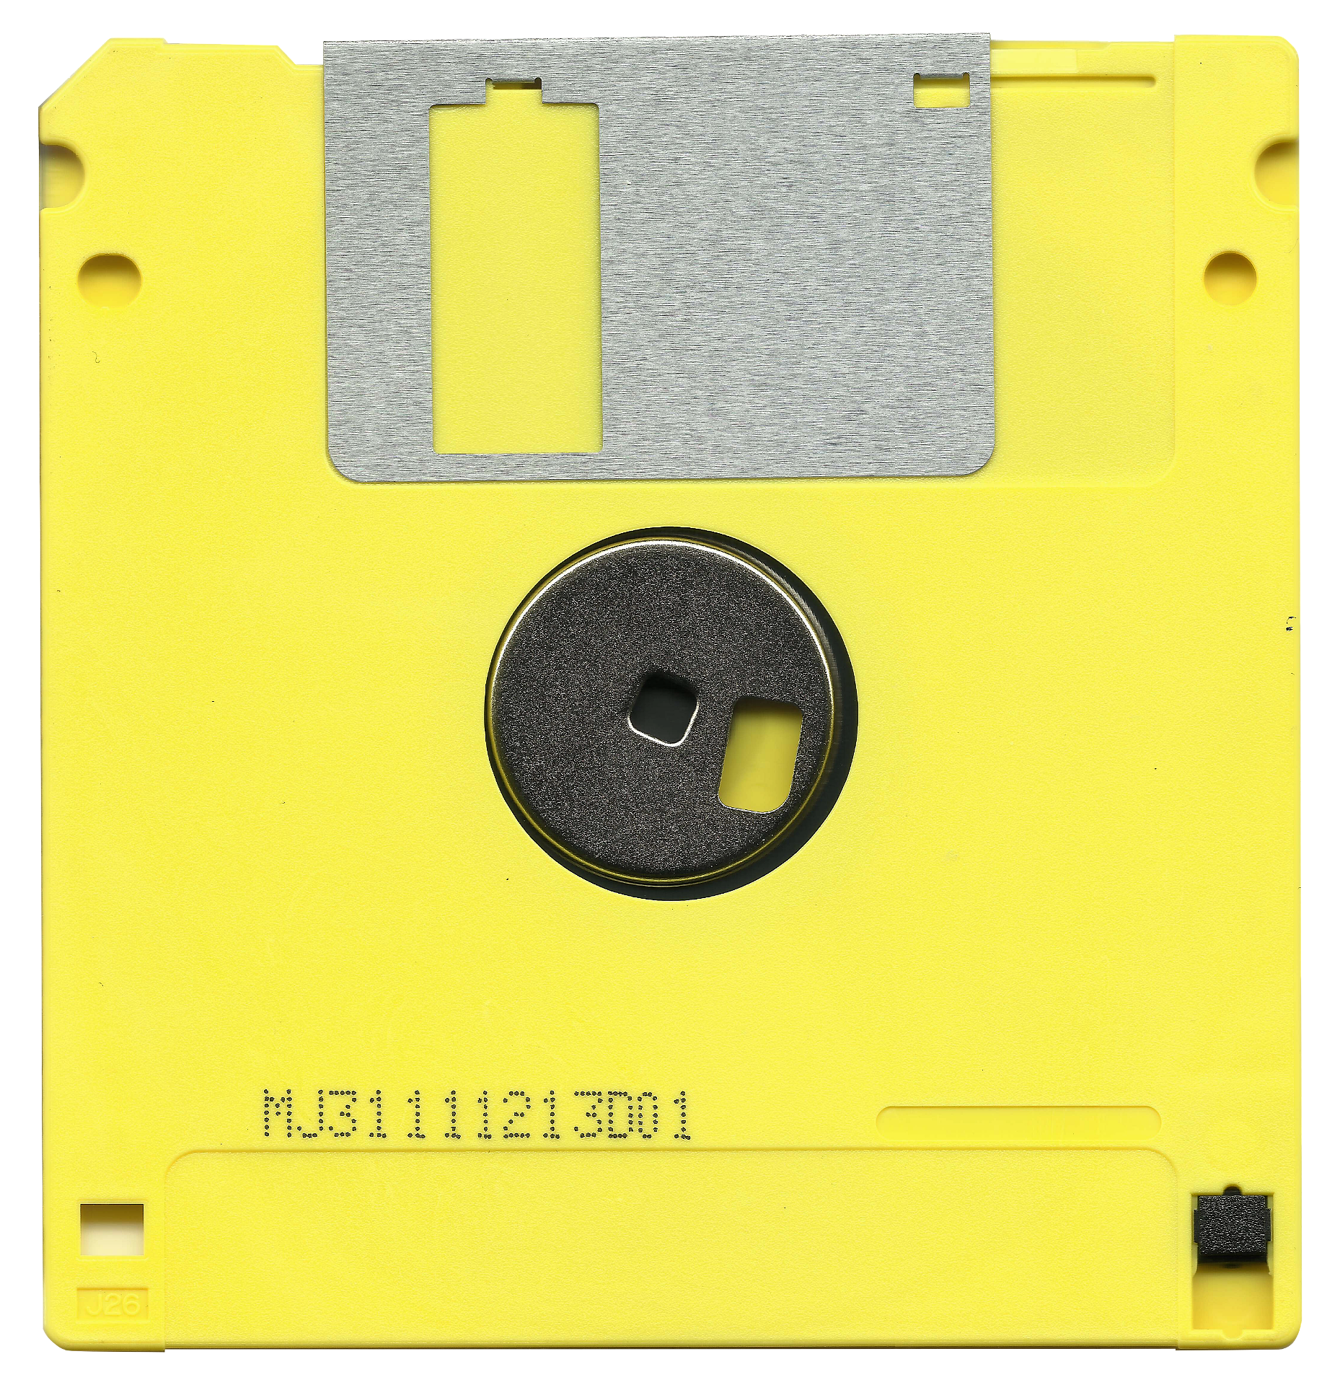
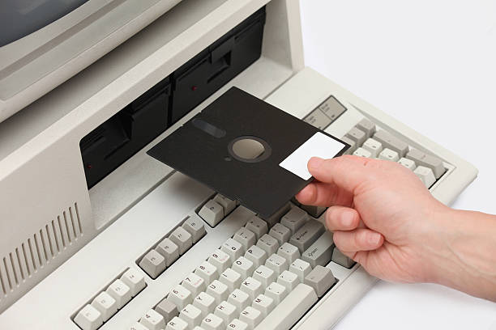
Floppy disk
The Floppy Disk was invented in 1967, with capacities ranging from 80 KB to 1.44 MB. It was widely used for storing and transferring data, functioning by magnetically storing data and reading it via a disk drive. It was first supported in Windows 1.0 released in 1985 and served as the primary storage medium until the late 1990s.

Slide 7
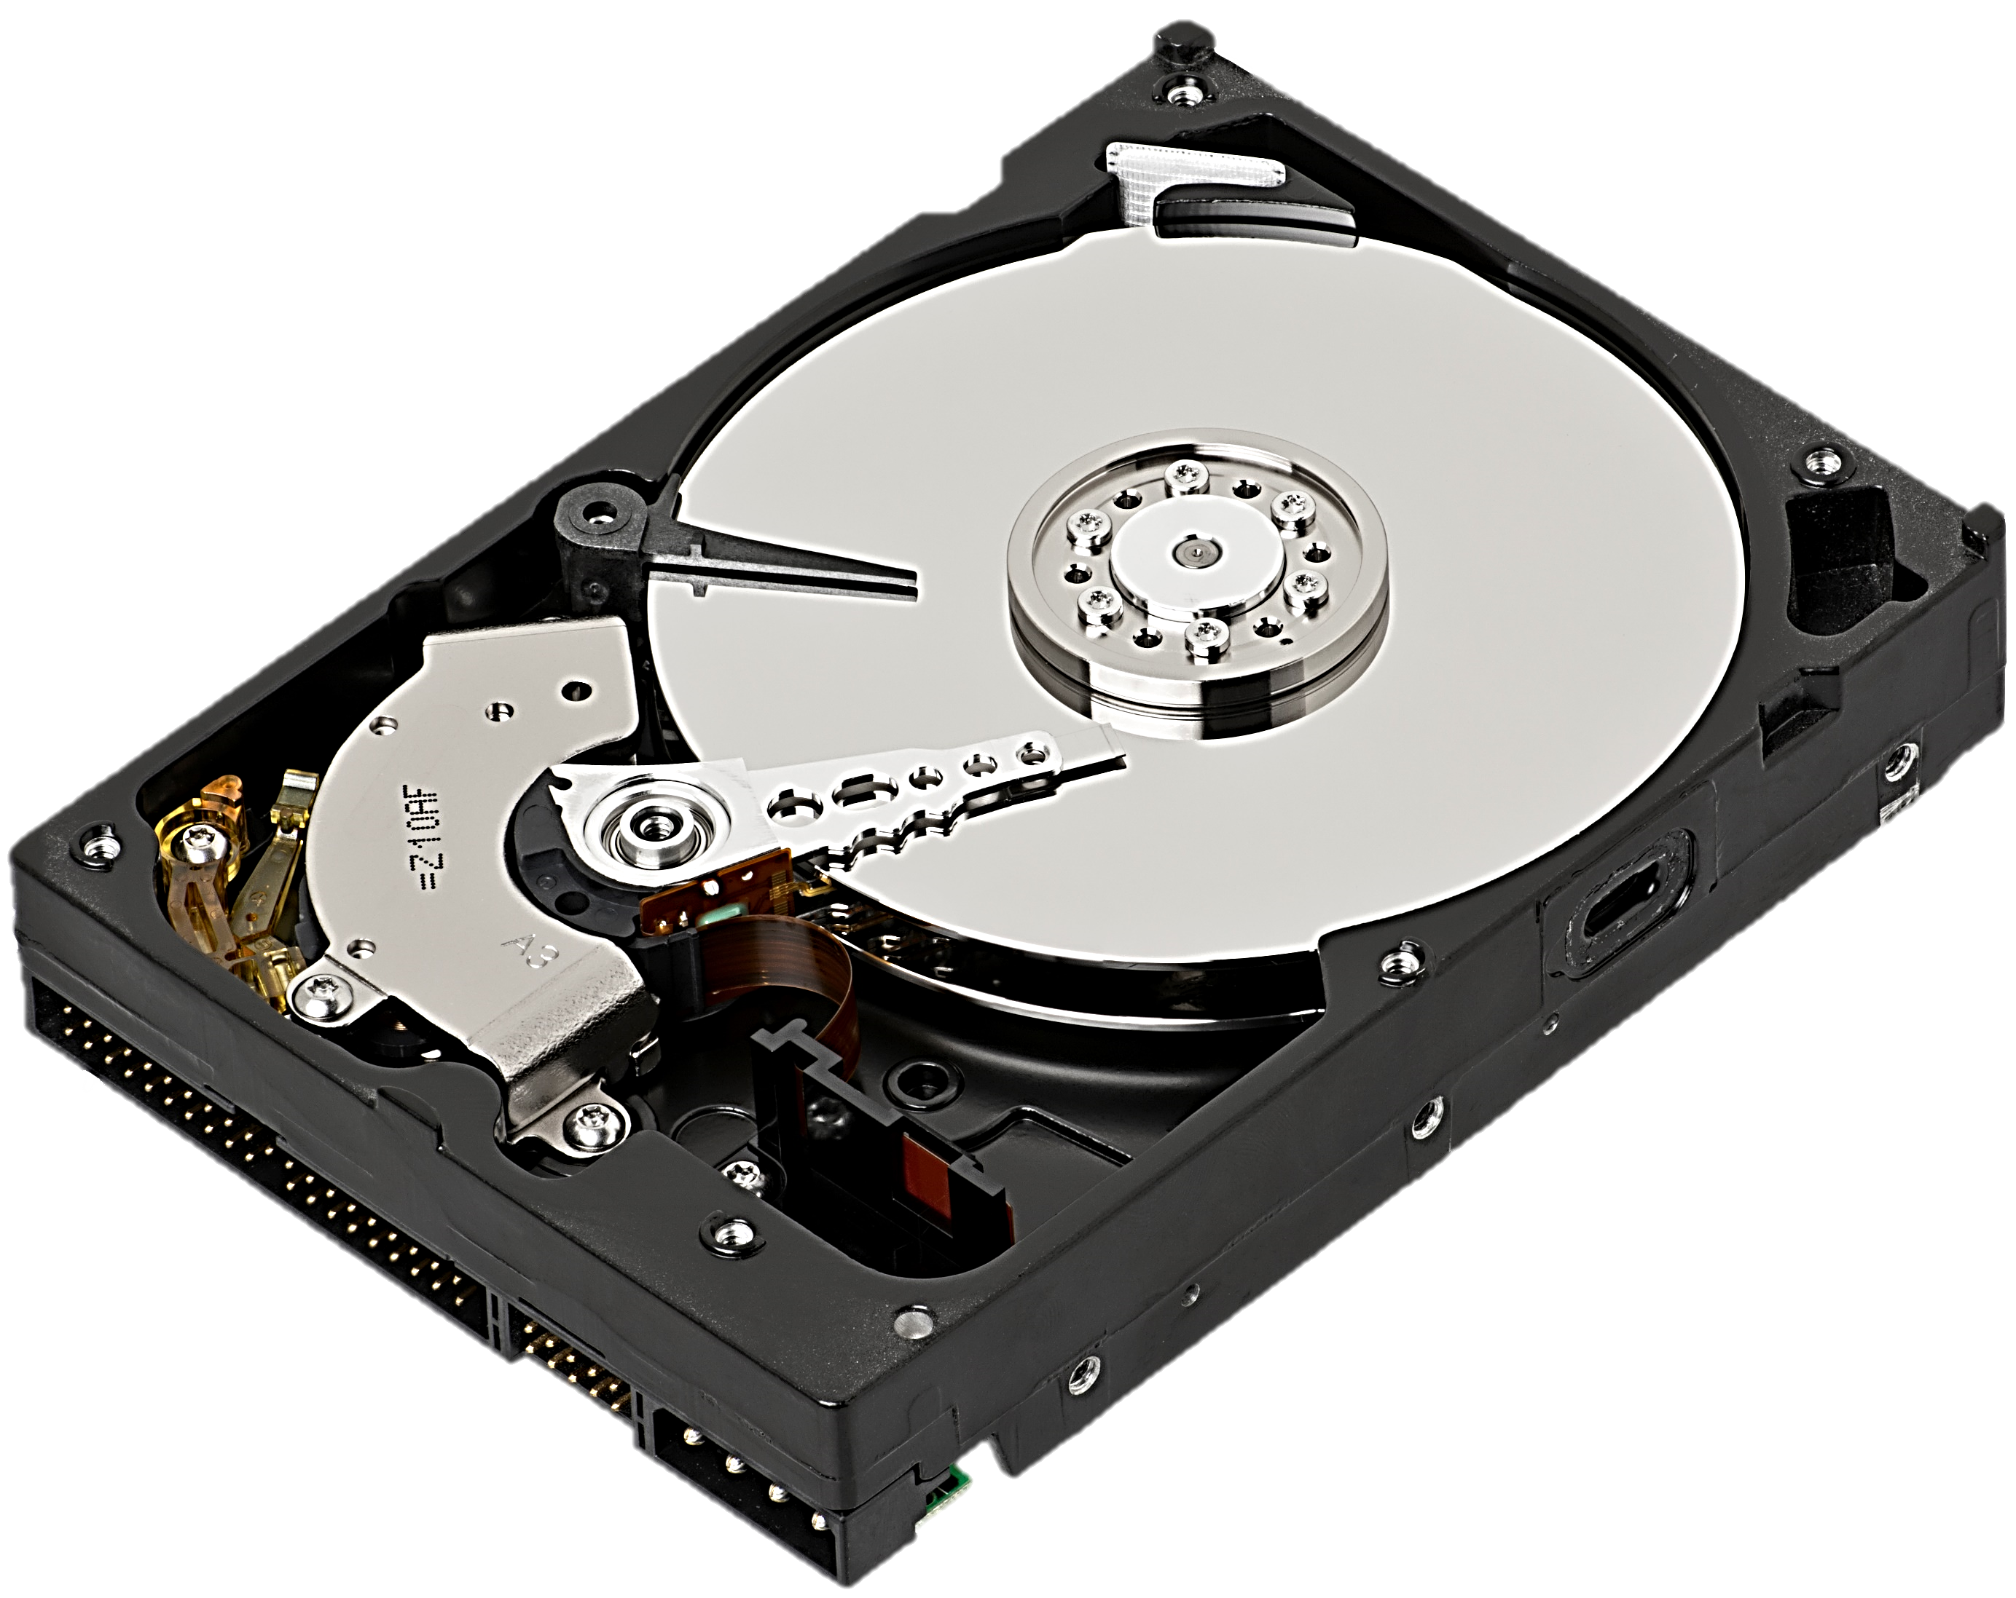
Hard disk Drive (HDD)
A Hard Disk Drive is a data storage device using magnetic storage to retrieve and store digital information, offering large capacity but slower speeds than SSDs.
Long-term Storage
Magnetic Hard Drive

Slide 8
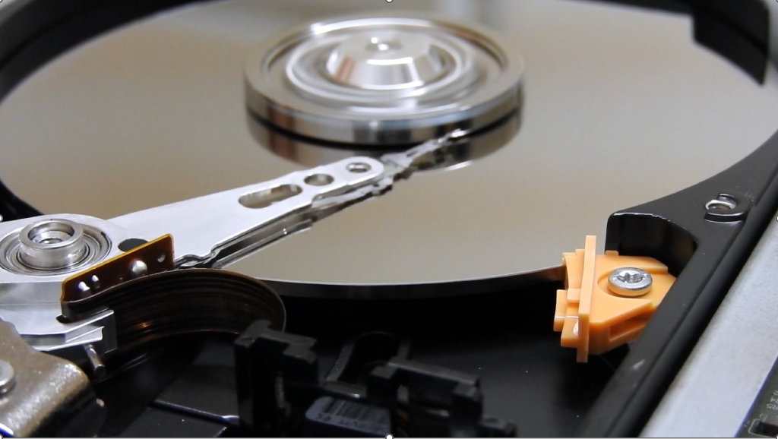

Slide 9
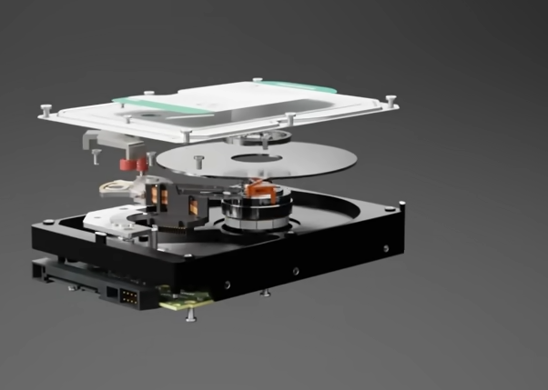
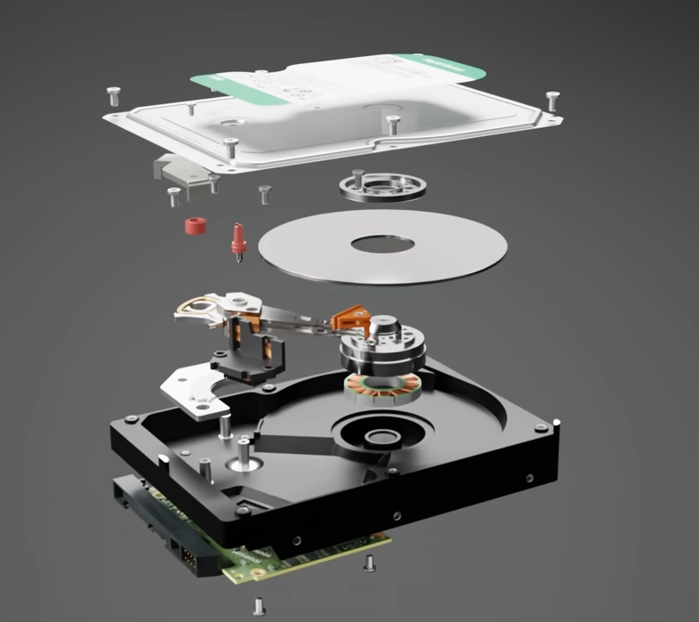
Platter
Actuator
R/W Head

Slide 10

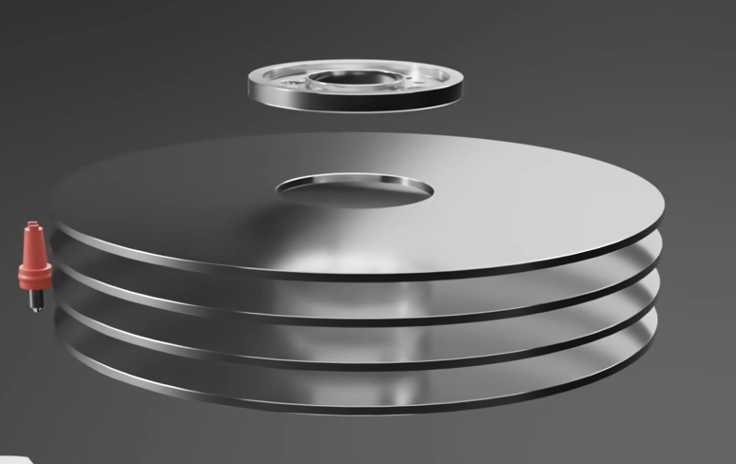
120nm

Slide 11
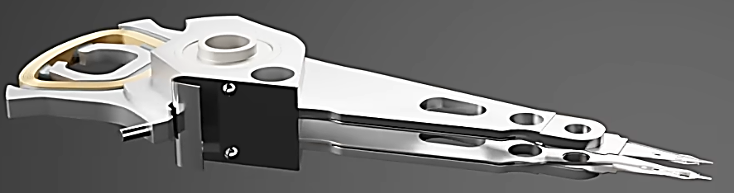
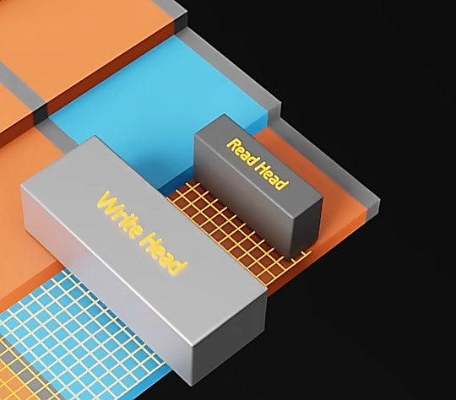
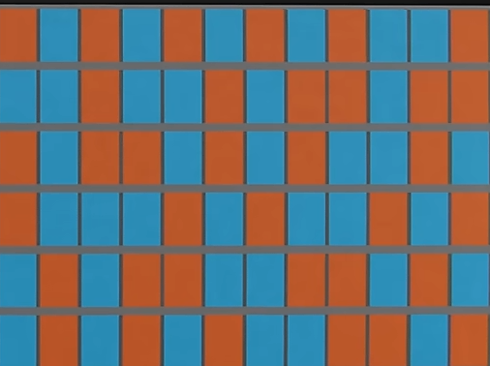
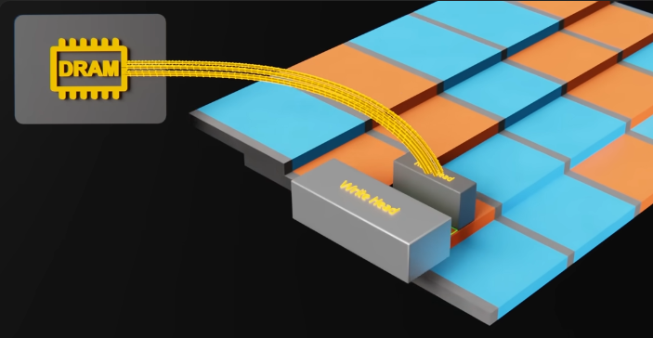

Slide 12

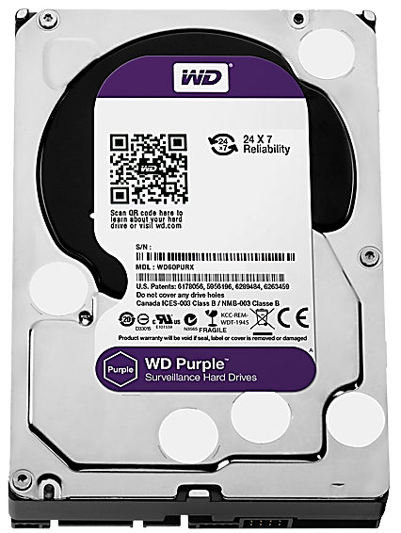
Hard disk selection factors
Speed 5400, 7200, 10000 and 15000 RPM
Capacity
Drive interface PATA || SATA

Slide 13
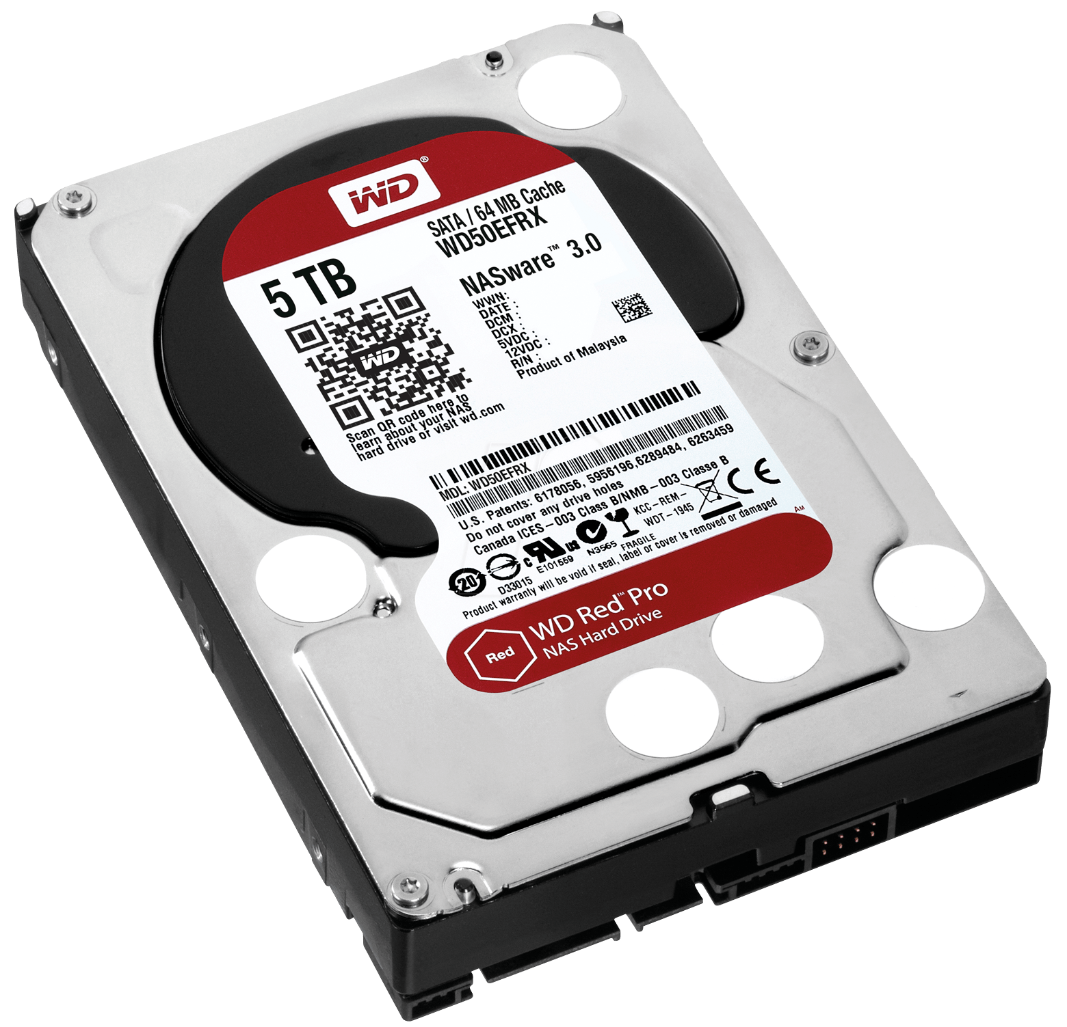

Traditional hard disk drive
Portable HDD

Slide 14
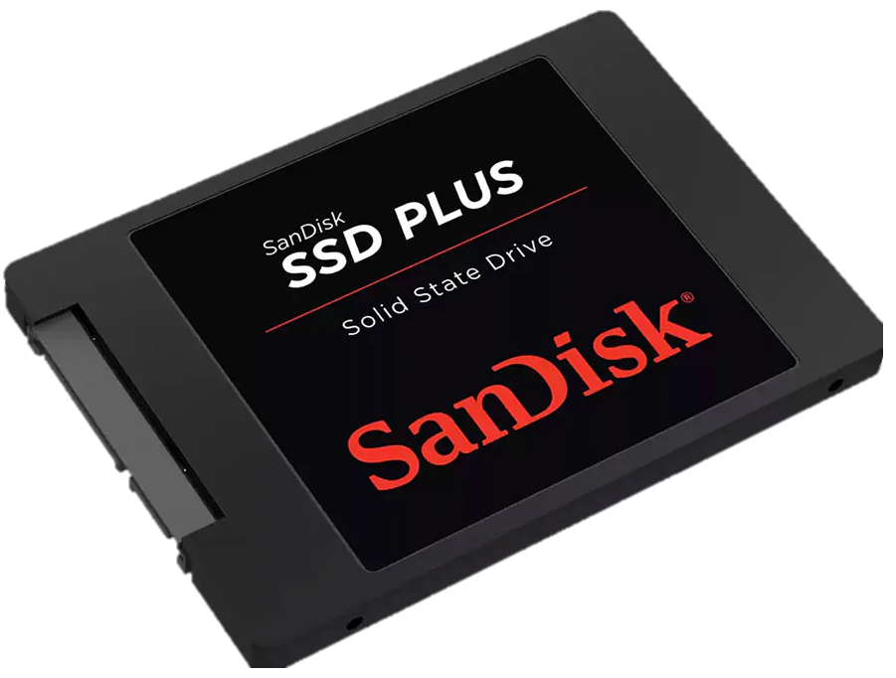
Solid state drive (SSD)
High speed
No noise
Higher durability
Lower power consumption
Smaller size
Low speed
Noise and vibration
Less durability
Higher power consumption
Larger size
2007: Solid State Drives (SSD) began to gain commercial popularity due to their high speed, durability, and lower power consumption compared to magnetic hard drives (HDD).
High cost

Slide 15
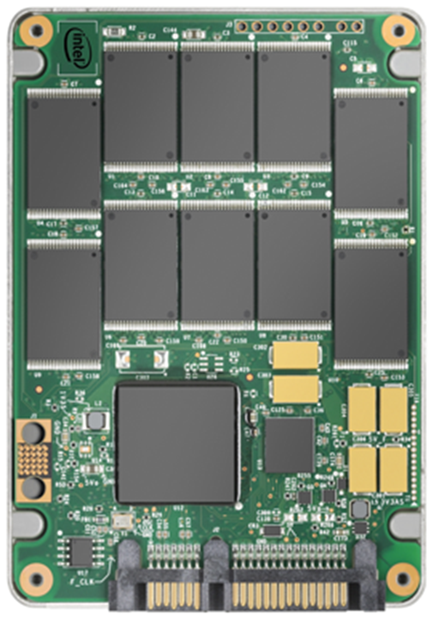
EEPROM (Electronically Erasable Programmable Read-Only Memory) chips
NAND (stands for “Not AND”).
NAND flash memory

Slide 16
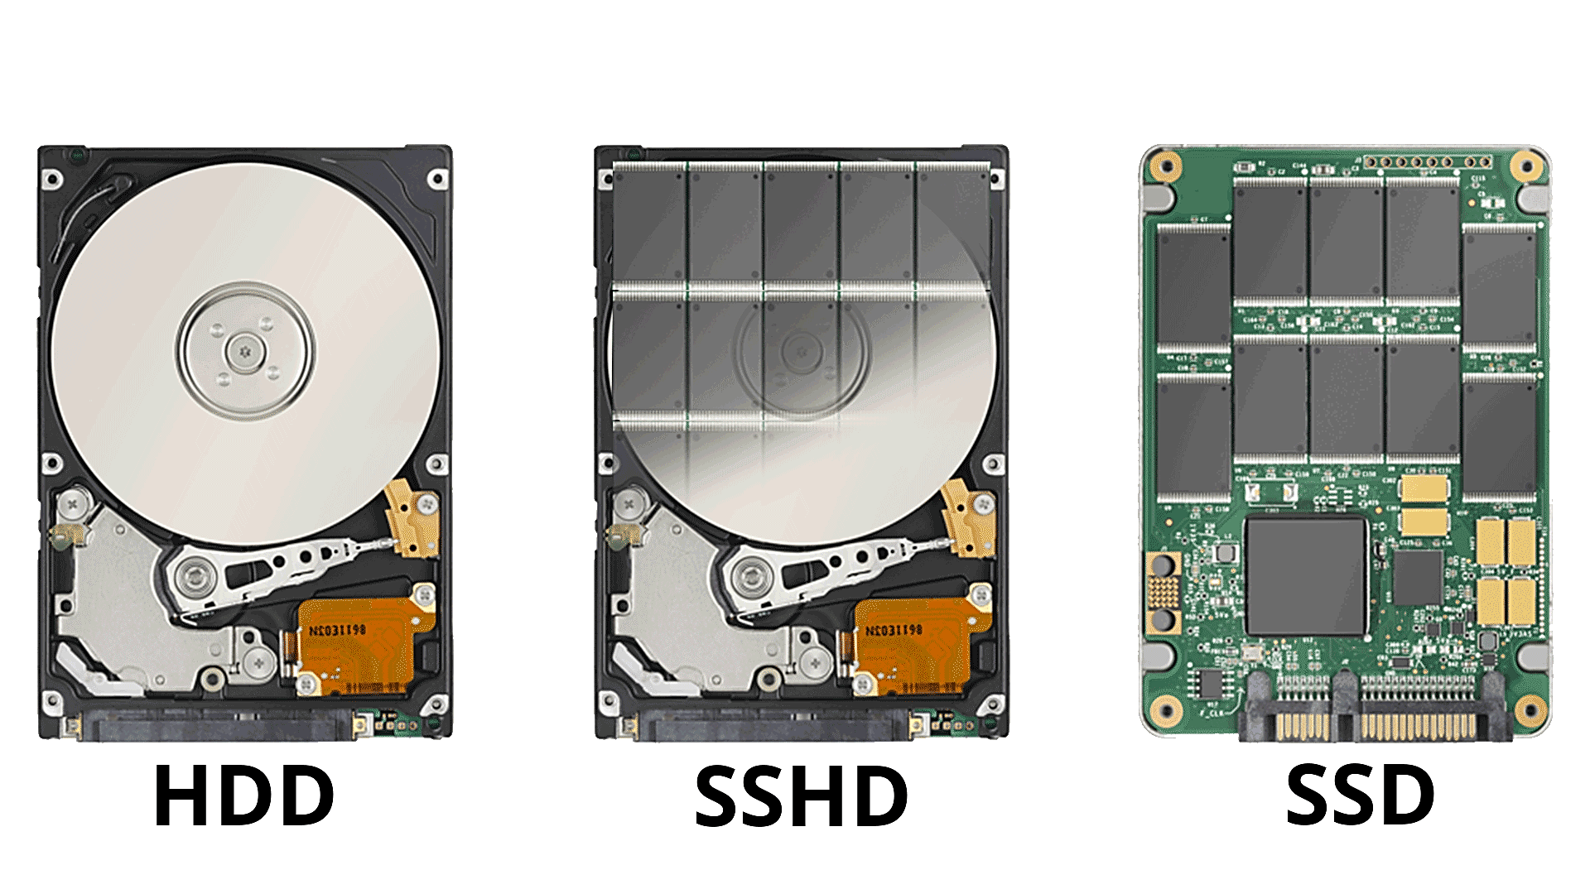
Hybrid Hard Drives
+
=

Slide 17
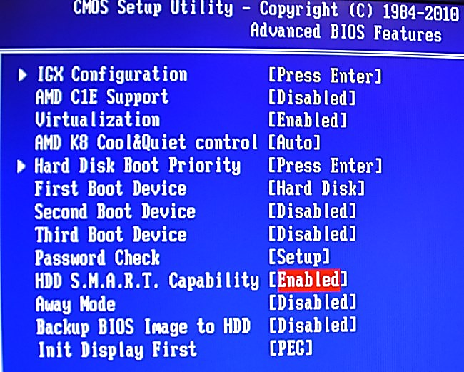
Logical Block Addressing(LBA)
S.M.A.R.T
Self-Monitoring Analysis and Reporting Technology

Slide 18
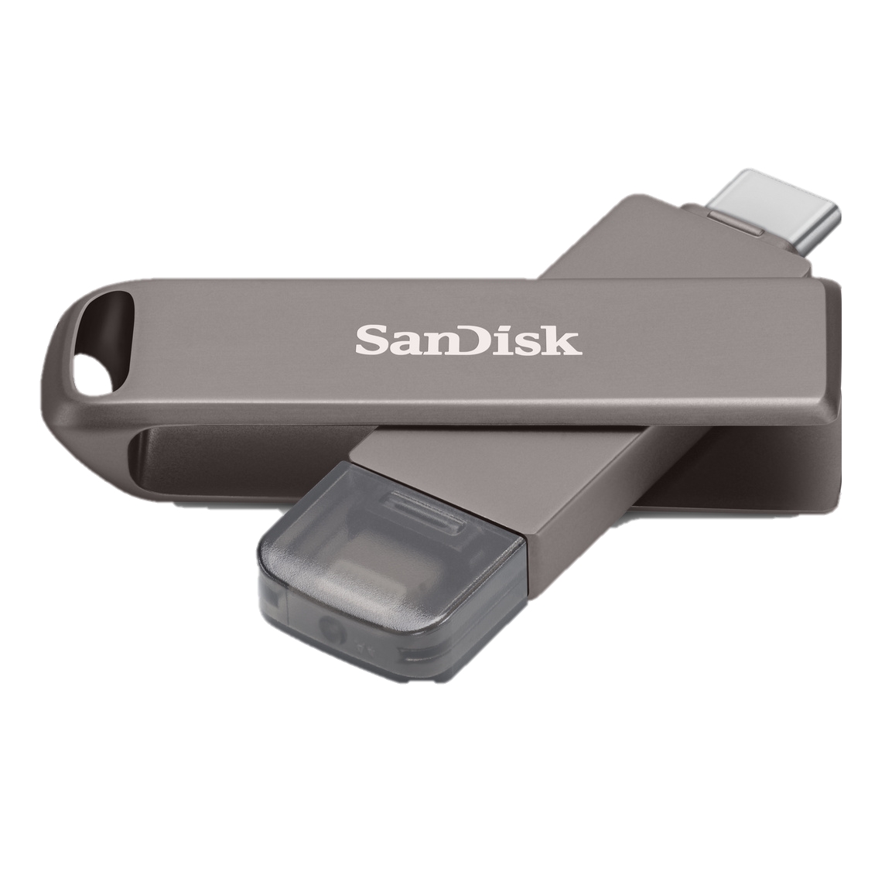
Universal Serial Bus (USB)
USB Flash Drives are portable storage devices that use flash memory technology, making them durable and fast.
Capacity and Speed
They are available in a variety of storage capacities, ranging from a few megabytes to terabytes, and feature different transfer speeds depending on the USB type.
Uses
They are used for transferring data between devices, storing backups, and installing operating systems.
Drawbacks
Despite their ease of use, they can be lost or wear out over time, which affects their lifespan.

Slide 19
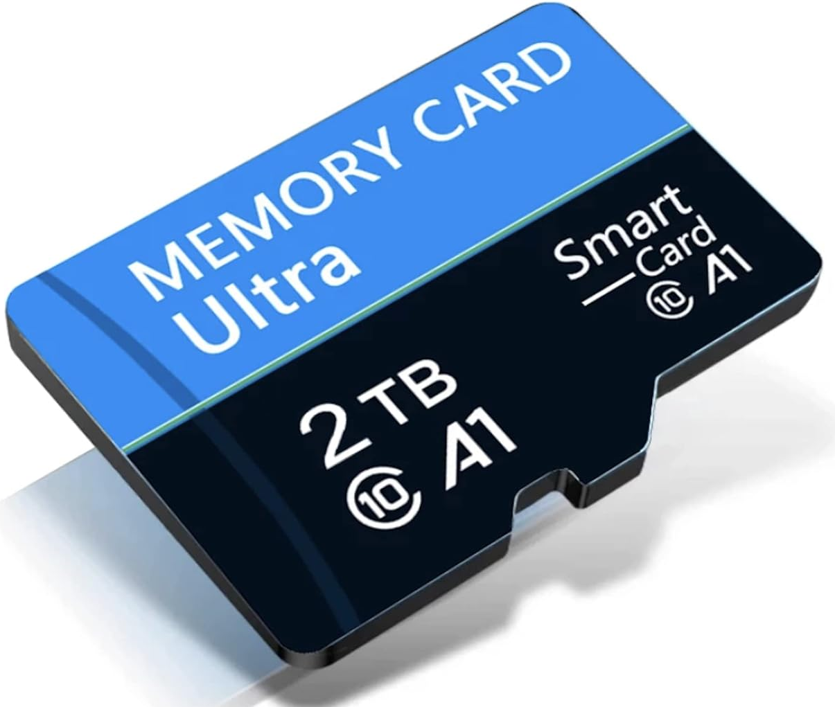
Memory Card
Memory Card: A small data storage medium used in portable devices such as smartphones, digital cameras, and gaming consoles. It offers various storage capacities and different transfer speeds.
Types:
SD (Secure Digital) Cards:
SD: Capacity of up to 2 GB.
SDHC (High Capacity): Ranges from 2 GB to 32 GB.
SDXC (Extended Capacity): Ranges from 32 GB to 2 TB.
microSD Cards:
microSD: Capacity of up to 2 GB.
microSDHC: Ranges from 2 GB to 32 GB.
microSDXC: Ranges from 32 GB to 2 TB.
CompactFlash (CF) Cards: Primarily used in professional cameras, providing high speeds and large capacities.
Memory Stick: A special type of memory card developed by Sony.

Slide 20

Compact Disc (CD)
CD (Compact Disc): A type of optical data storage medium, with a capacity of up to 700 MB. Used for storing music, software, and data, it is portable and easy to use.
Types:
CD-ROM: For storing data and information.
CD-R: Can be written once.
CD-RW: Can be written and rewritten multiple times.

Slide 21

Digital Versatile Disc (DVD)
DVD (Digital Versatile Disc): An optical storage medium with a capacity of up to 4.7 GB (DVD-5) and 8.5 GB (DVD-9). Used for storing movies, software, and data, it offers high quality.
Types:
DVD-ROM: For storing movies and software.
DVD-R: Can be written once.
DVD-RW: Can be written and rewritten multiple times.

Slide 22
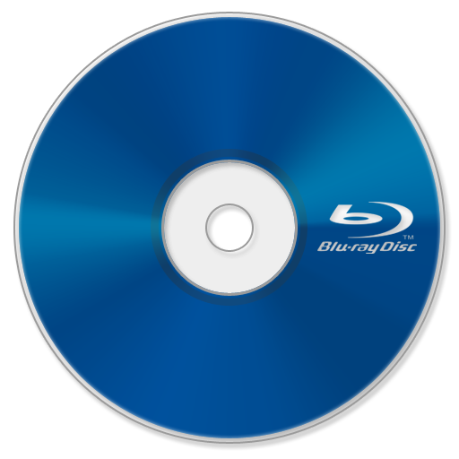
Blu-ray Disc
Blu-ray Disc: An optical storage medium with a high capacity of up to 25 GB (BD-25) and 50 GB (BD-50). Primarily used for storing high-definition video and games, it offers excellent picture and sound quality.
Types:
BD-ROM: For storing movies and games.
BD-R: Can be written once.
BD-RW: Can be written and rewritten multiple times.

Slide 23
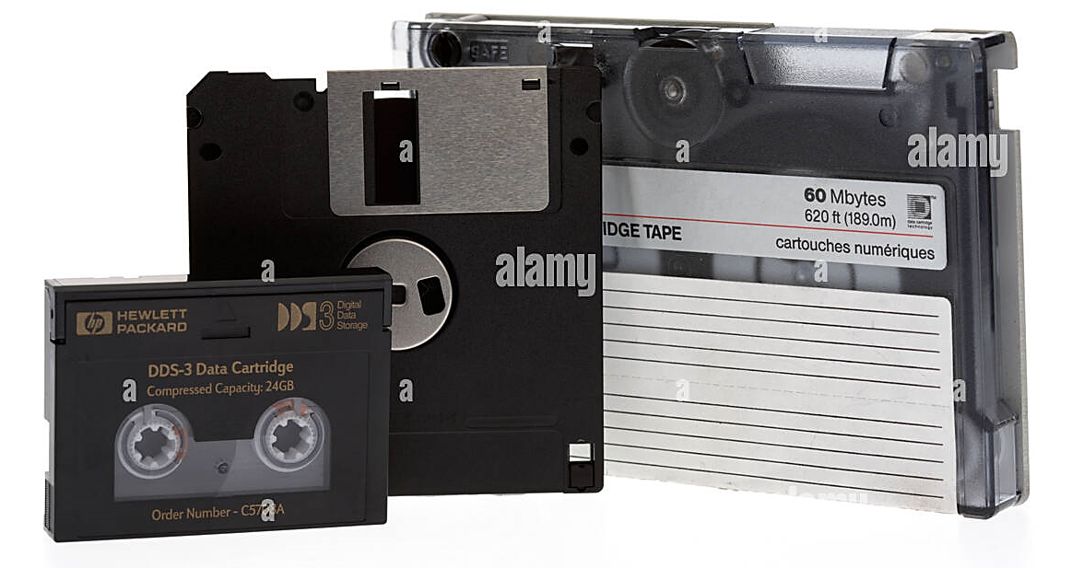
Tape Drive
Tape Drive: A storage medium that uses magnetic tapes, primarily used for backup and data recovery.
Advantages:
Large Capacity: Can store terabytes of data.
Low Cost: Cheaper than hard drives per terabyte.
Durability: Lasts for years with proper storage.
Disadvantages:
Slow Access Speed: Slower than hard drives and SSDs.
Complexity: Requires special equipment.
Uses:
Backup of important data.
Long-term data storage.

Slide 24
Storage Devices Interfaces

Slide 25
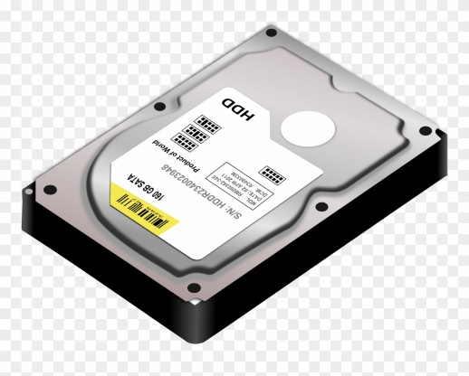
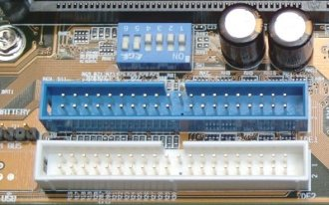
Parallel ATA ( PATA )(IDE)
HDD
CD / DVD
Internal

Slide 26


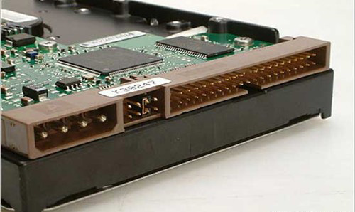
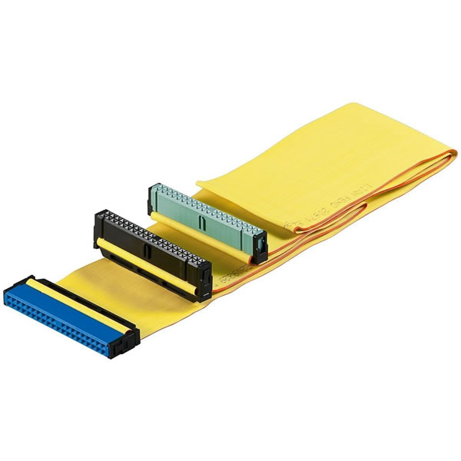
Master/Slave Config.

Slide 27
Seral ATA (SATA)
HDD
CD / DVD
Internal
External
Hot-Swapping

Slide 28


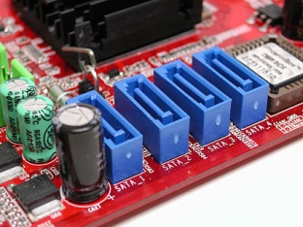
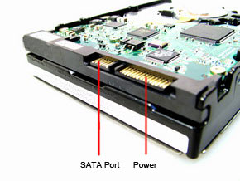

Slide 29
PATA VS SATA
PATA | SATA
Parallel Connection | Serial Connection
Max. Speed up to 133 MB/s | Speed starts from 150 MB/s 300 MB/s 600 MB/s

Slide 30
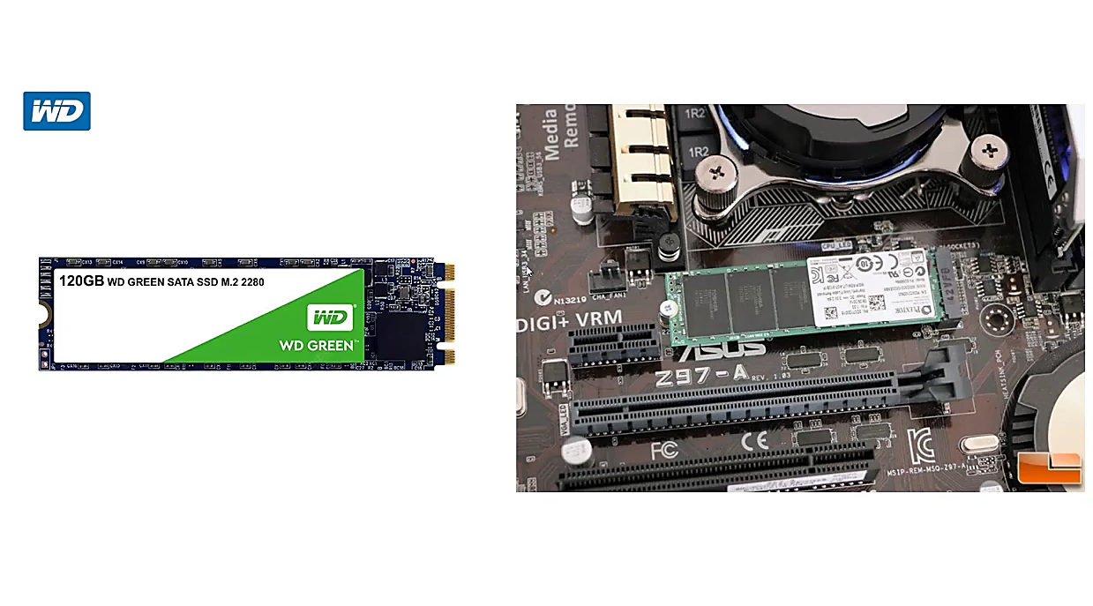

Slide 31
Small Computer System Interface (SCSI)
HDD
CD/DVD
Internal
External

Slide 32

Tank you

